Slide 1
Machine Learning
AIML CZG565
M8 : Bayesian Learning
Course Faculty of M.Tech Cluster
BITS – CSIS - WILP

Slide 2

Machine Learning
Disclaimer and Acknowledgement
These content of modules & context under topics are planned by the course owner Dr. Sugata, with grateful acknowledgement to many others who made their course materials freely available online
We here by acknowledge all the contributors for their material and inputs.
We have provided source information wherever necessary
Students are requested to refer to the textbook w.r.t detailed content of the presentation deck shared over canvas
We have reduced the slides from canvas and modified the content flow to suit the requirements of the course and for ease of class presentation
Slide Source / Preparation / Review:
From BITS Pilani WILP: Prof.Sugata, Prof.Chetana, , Prof.Monali, Prof.Rajavadhana
External: CS109 and CS229 Stanford lecture notes, Dr.Andrew NG and many others who made their course materials freely available online

Slide 3
Course Plan
M1 | Introduction & Mathematical Preliminaries
M2 | Machine Learning Workflow
M3 | Linear Models for Regression
M4 | Linear Models for Classification
M5 | Decision Tree
M6 | Instance Based Learning
M7 | Support Vector Machine – Planned to be discussed in CS 15 or CS 16
M8 | Bayesian Learning
M9 | Ensemble Learning
M10 | Unsupervised Learning
M11 | Machine Learning Model Evaluation/Comparison

Slide 4
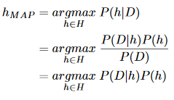
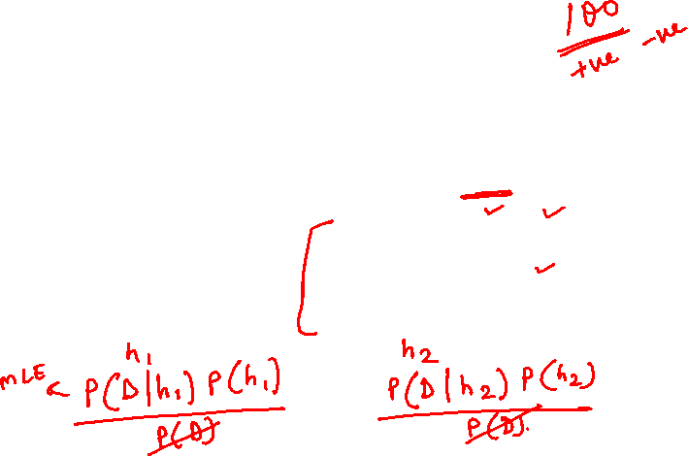
Maximum A Posteriori (MAP) Analysis
Determine prior probability
Find the posterior probability for every distinct prior
Choose the posterior with highest h_{MAP} value
𝜃_{𝑀𝐴𝑃} = arg max 𝑓(𝜃|𝑋₁, 𝑋₂, … , 𝑋_{𝑛})
Brute Force MAP Hypothesis
Maximum a Posteriori (MAP) Estimator of 𝜃 is the value of 𝜃 that maximizes the posterior distribution of 𝜃.
Best hypothesis ≈ most probable hypothesis

Slide 5
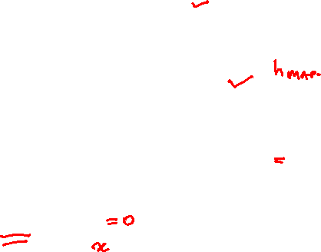
Maximum A Posteriori Estimation (MAP)
Find the prior probability
Derive the posterior probability
Differentiate posterior w.r.t. (each) 𝜃
Solve
Maximum a Posteriori (MAP) Estimator of 𝜃 is the value of 𝜃 that maximizes the posterior distribution of 𝜃.
Best hypothesis ≈ most probable hypothesis

Slide 6
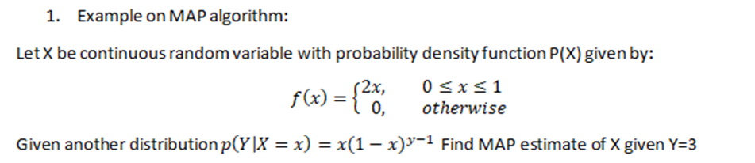
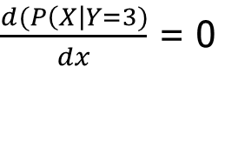


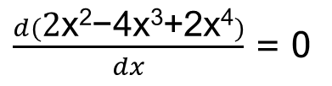
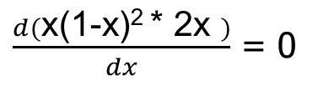
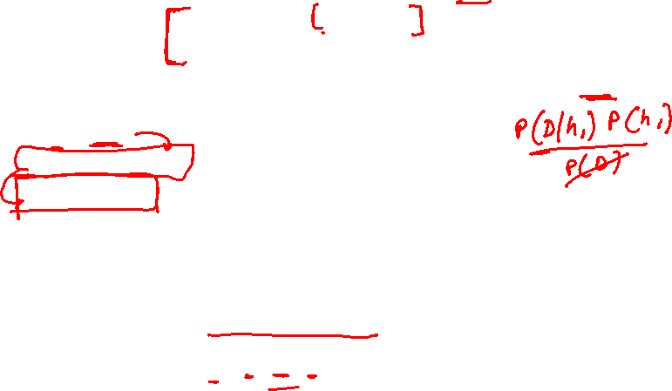
Example :
h _{MAP} = P( X | Y=3)
= P(Y=3 | X) * P(X)
= x(1-x)^{y-1} * 2x
To find the parameter x , differentiate the function & equate to zero.
$\frac{d(P\left(X\right|Y=3)}{dx}$ = 0
$\frac{d(\text{2}\text{x}\text{2}\text{−}\text{4}\text{x}\text{3}\text{+2}\text{x}\text{4})}{dx}$ = 0
$\text{4}\text{x}\text{−12}\text{x}\text{2}\text{+8}\text{x}3$= 0
$\frac{d(\text{x}\text{(1−}\text{x}\text{)2 ∗ 2}\text{x} )}{dx}$ = 0
$x$ = {0, 0.5, 1}

Slide 7
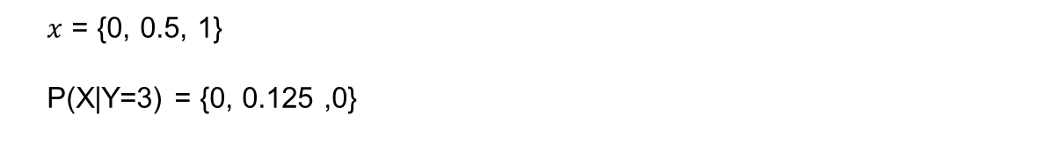
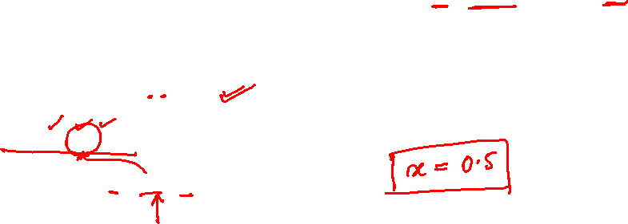
Example :
h _{MAP} = P( X | Y=3)
= P(Y=3 | X) * P(X)
= x(1-x)^{y-1} * 2x
$x$ = {0, 0.5, 1}
P(X|Y=3) = {0, 0.125 ,0}

Slide 8
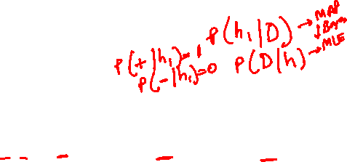
Most Probable Classification of New Instances
So far we’ve sought the most probable hypothesis given the data D (i.e., h_{MAP})
Given new instance x, what is its most probable classification?
  h_{MAP}(x) is not the most probable classification!
  What’s most probable classification of x?
Consider:
Three possible hypotheses:
P(h₁|D) = .4, P(h₂|D) = .3, P(h₃|D) = .3
Given new instance x, classification given by above 3 hypotheses is
h₁(x) = +, h₂(x) = −, h₃(x) = −
May be the classification for X is +
and

Slide 9
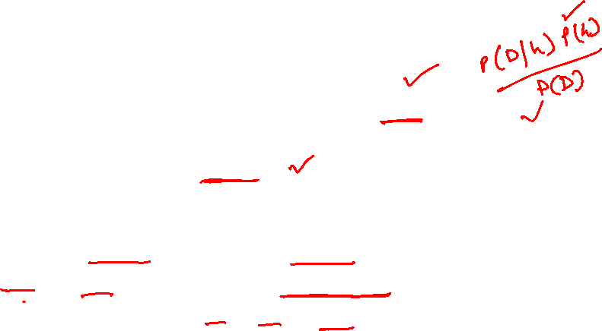
ML setting
Bayesian Analysis
  start with some belief about the system, called a prior.
  Then we obtain some data and use it to update our belief.
  The outcome is called a posterior.
  Should we obtain even more data, the old posterior becomes a new prior and the cycle repeats.
  P(h | D) a posterior determines the class label
  MLE and MAP are the same if the prior is uniform
  This forms the basis for Naïve Bayes classifier → More on this will be discussed in later part of this module

Slide 10


Bayes’ Optimal Classifier
The most probable classification of the new instance is obtained by combining the predictions of all hypotheses, weighted by their posterior probabilities.
v_{j} from some set V, then the probability P(v_{j} l D) that the correct classification for the new instance is v_{j} is:
The optimal classification of the new instance is the value vj for which P(v_{j} l D) is maximum

Slide 11

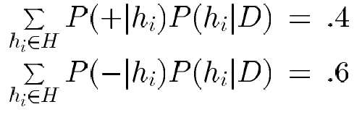

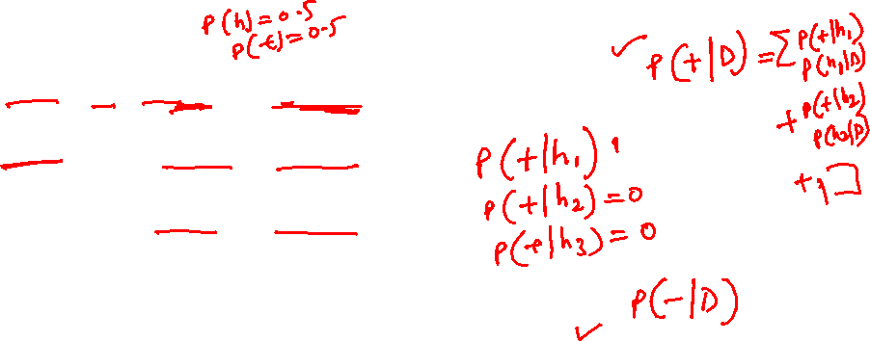
Example 1 : Bayes Optimal Classifier
Bayes optimal classification:
Example:
P(h₁|D) = .4, P(−|h₁) = 0, P(+|h₁) = 1
P(h₂|D) = .3, P(−|h₂) = 1, P(+|h₂) = 0
P(h₃|D) = .3, P(−|h₃) = 1, P(+|h₃) = 0
therefore
and

Slide 12

Gibbs Classifier
Bayes optimal classifier provides best result, but can be expensive if many hypotheses.
Gibbs algorithm:
  Choose one hypothesis at random, according to posterior prob. Distribution over h , P(h|D)
  Use this h to classify new instance
Surprising fact: under certain conditions, the expected misclassification error for the Gibbs algorithm is at most twice the expected error of the Bayes optimal classifier
E[error_{Gibbs}] ≤ 2E [error_{BayesOptional}]
Suppose correct, uniform prior distribution over H, then
  Pick any hypothesis from Version space, with uniform probability
  Its expected error no worse than twice Bayes optimal

Slide 13
Parameter Estimation in ML - Summary
Assumption: Data are__
  IID samples: X₁…X_{n}
  where all X_{i} are independent and have the same distribution.
  Either same PMF (discrete) or same PDF (continuous)
f (X | 𝜃)
  Likelihood of different values of X depends on the values of our parameters 𝜃
  f( ) is either PDF or PMF
Parameters : ($θ$₀, $θ$₁, $θ$₂)
Find $θ=(θ\text{0}\text{, }θ\text{1}\text{, }θ\text{2})$ from the data X_{i}
  Maximum Likelihood Estimation (MLE)
    select that parameters 𝜃 that make the observed data the most likely
  Maximum A Posteriori (MAP)
    choose the parameters 𝜃 that is the most likely, given the data
f (X₁ , X₂ .....X_{n} | $θ$)
f ($θ$ | X₁ , X₂ .....X_{n})
If the sample is large, MLE will yield an excellent estimator of θ
When no prior information is available, all hypothesis are equally likely i.e. p(hi) = p(hj)

Slide 14
Naïve Bayes Classifier

Slide 15
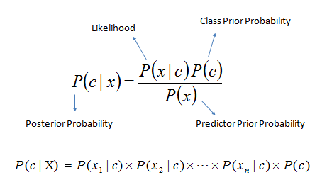
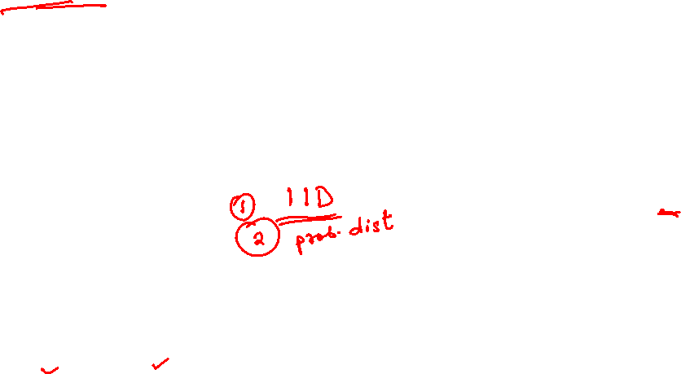
Refresh from Pre-Mid Term
Decision Theory: Interpretation Model Building
Generative
x₂
x₁
Sky | AirTemp | Humidity | Wind | Forecast | Enjoy Sport?
Sunny | Warm | Normal | Strong | Same | Yes
Sunny | Warm | High | Strong | Same | No
Rainy | Cold | High | Strong | Change | No
Sunny | Warm | Normal | Breeze | Same | Yes
Sunny | Hot | Normal | Breeze | Same | No
Rainy | Cold | High | Strong | Change | No
Sunny | Warm | High | Strong | Change | Yes
Rainy | Warm | Normal | Breeze | Same | Yes
Known as generative models, because by sampling from them it is possible to generate synthetic data points in the input space.
Eg., Gaussians, Naïve Bayes, Mixtures of multinomials , Mixtures of Gaussians, Bayesian networks

Slide 16
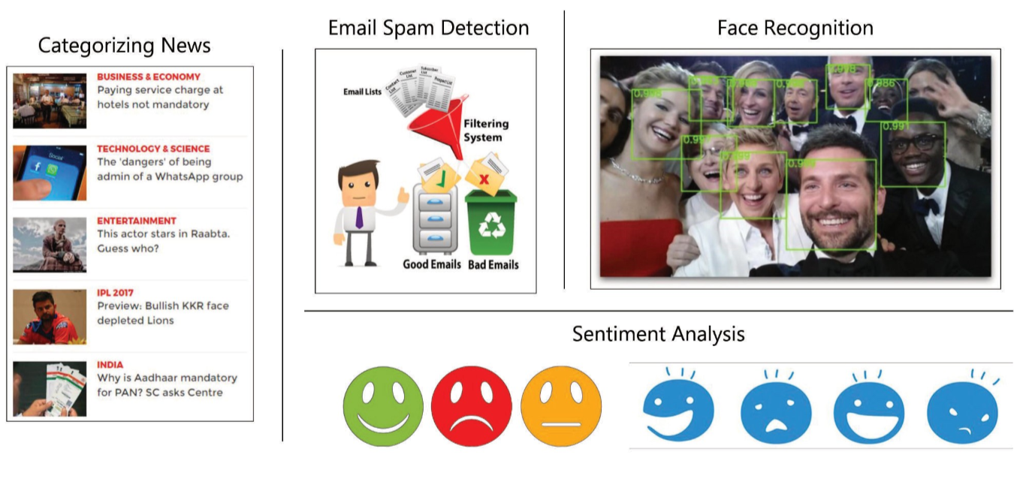
Naïve Bayes Classifier - Applications

Slide 17
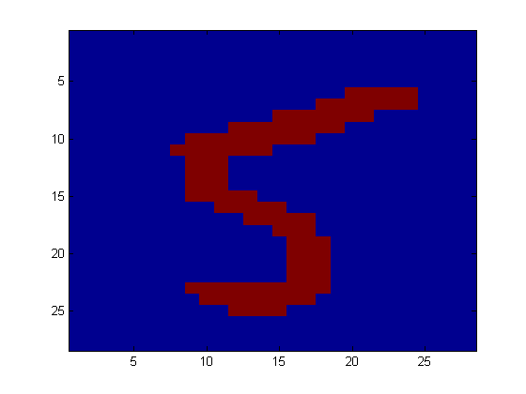
Example: Digit Recognition
X₁,…,X_{n} ∈ {0,1} (Black vs. White pixels)
Y ∈ {5,6} (predict whether a digit is a 5 or a 6)
Classifier

Slide 18
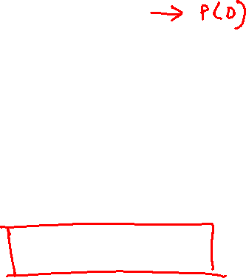
Generative models for classification
For binary classification the denominator is given by
p(x) = p(x|y = 1)p(y = 1) + p(x|y = 0)p(y = 0)
if we’re calculating p(y|x) in order to make a prediction, then we don’t actually need to calculate the denominator, since

Slide 19
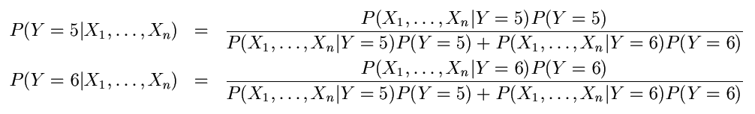

The Bayes Classifier
To classify, we’ll simply compute these two probabilities and predict based on which one is greater

Slide 20
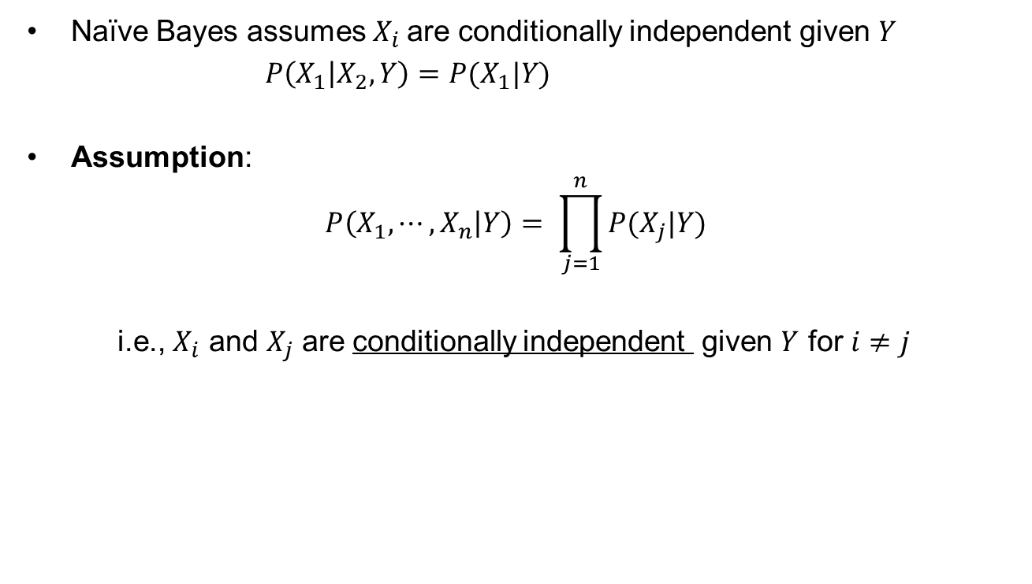
Naïve Bayes conditional Independence assumption
Naïve Bayes assumes $X_{i}$are conditionally independent given $Y$
$P\left(X_{1} | X_{2}, Y\right)=P(X_{1}|Y)$
Assumption:
$$P\left(X_{1}, ⋯,X_{n} | Y\right)= \prod_{j=1}^{n}{P(X_{j}|Y)}$$
i.e., $X_{i}$ and $X_{j}$ are conditionally independent given $Y$ for $i≠j$

Slide 21
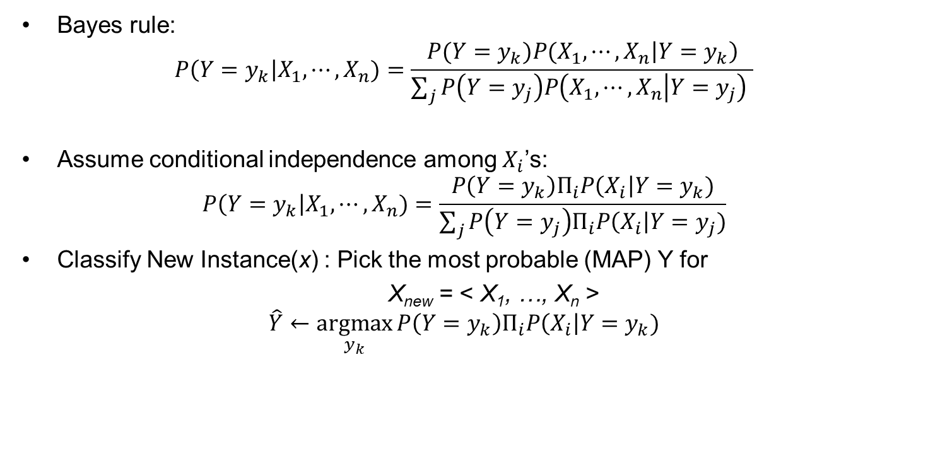
Naïve Bayes classifier: Prediction
Goal of learning P(Y|X) where X = <X₁,…, X_{n}>
Bayes rule:
$$P\left(Y=y_{k}\right|X_{1}, ⋯,X_{n})=\frac{{P(Y=y_{k})P(X_{1},⋯,X}_{n}\left|Y=y_{k}\right)}{\sum_{j}{P\left(Y=y_{j}\right)P\left(X_{1},⋯, X_{n} | Y=y_{j}\right) }}$$
Assume conditional independence among $X_{i}$’s:
$$P\left(Y=y_{k}\right|X_{1}, ⋯,X_{n})=\frac{P\left(Y=y_{k}\right)Π_{i}P\left(X_{i}\right|Y=y_{k})}{\sum_{j}{P\left(Y=y_{j}\right)Π_{i}P\left(X_{i}\right|Y=y_{j})}}$$
Classify New Instance(x) : Pick the most probable (MAP) Y for
X_{new} = < X₁, …, X_{n} >
$$\hat{Y}←\underset{y_{k}}{argmax}{P\left(Y=y_{k}\right)Π_{i}P\left(X_{i}\right|Y=y_{k})}$$
Prior
Likelihood

Slide 22
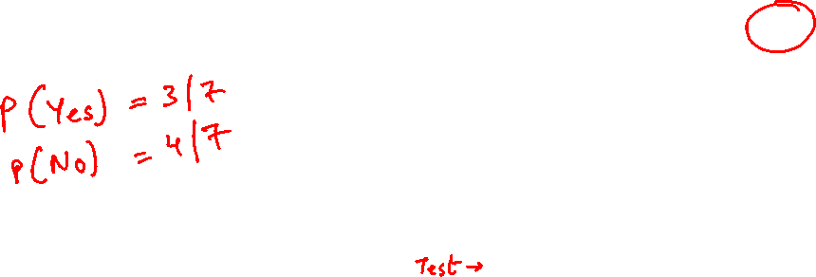
Example: Play Tennis
P(X|Y)$\sim Multinom\left(π,n\right)$ $→ Multinomial NB$ (X_{i} – multinomial)
P($Y$) ~ Ber(p)
Sky | AirTemp | Humidity | Wind | Forecast | Enjoy Sport?
Sunny | Warm | Normal | Strong | Same | Yes
Sunny | Warm | High | Strong | Same | No
Rainy | Cold | High | Strong | Change | No
Sunny | Warm | Normal | Breeze | Same | Yes
Sunny | Hot | Normal | Breeze | Same | No
Rainy | Cold | High | Strong | Change | No
Sunny | Warm | High | Strong | Change | Yes
Rainy | Warm | Normal | Breeze | Same | Yes
$$\hat{Y}←\underset{y_{k}}{argmax}{P\left(Y=y_{k}\right)Π_{i}P\left(X_{i}\right|Y=y_{k})}$$

Slide 23
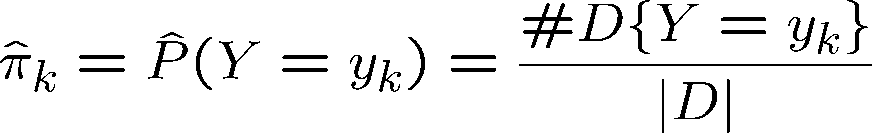
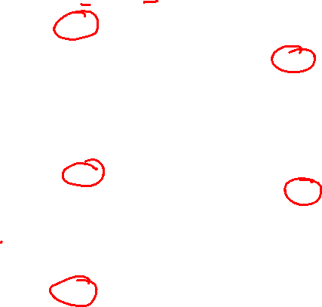
Example: Play Tennis – Learning Phase
  Look up tables
Maximum likelihood estimates (MLE’s):
Sky | Play=Yes | Play=No
Sunny | 3/3 | 2/4
Rainy | 0/3 | 2/4
Number of items in dataset D for which Y=y_{k}
Wind | Play=Yes | Play=No
Strong | 2/3 | 3/4
Breeze | 1/3 | 1/4
Sky | AirTemp | Humidity | Wind | Forecast | Enjoy Sport?
Sunny | Warm | Normal | Strong | Same | Yes
Sunny | Warm | High | Strong | Same | No
Rainy | Cold | High | Strong | Change | No
Sunny | Warm | Normal | Breeze | Same | Yes
Sunny | Hot | Normal | Breeze | Same | No
Rainy | Cold | High | Strong | Change | No
Sunny | Warm | High | Strong | Change | Yes
Rainy | Warm | Normal | Breeze | Same | Yes
AirTemp | Play=Yes | Play=No
Hot | 0/3 | 1/4
Warm | 3/3 | 1/4
Cold | 0/3 | 2/4
Forecast | Play=Yes | Play=No
Same | 2/3 | 2/4
Change | 1/3 | 2/4
Humidity | Play=Yes | Play=No
High | 1/3 | 3/4
Normal | 2/3 | 1/4

Slide 24
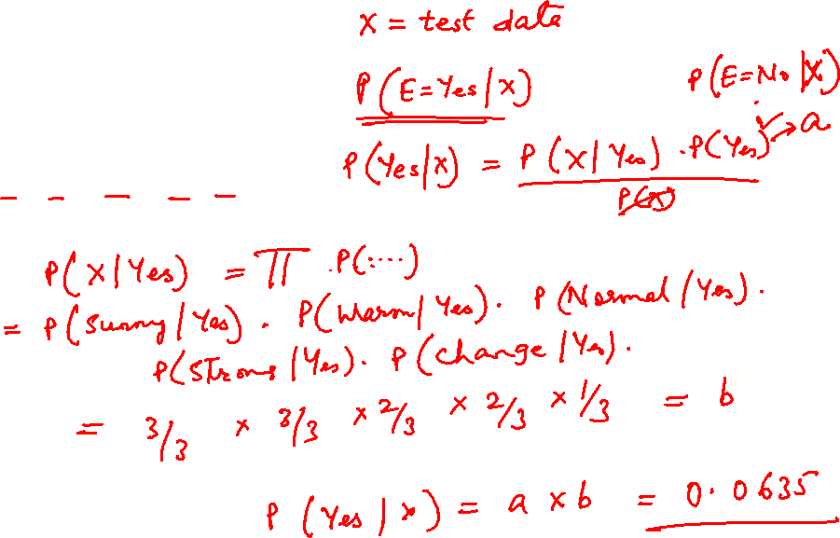
Sky | AirTemp | Humidity | Wind | Forecast | Enjoy Sport?
Sunny | Warm | Normal | Strong | Same | Yes
Sunny | Warm | High | Strong | Same | No
Rainy | Cold | High | Strong | Change | No
Sunny | Warm | Normal | Breeze | Same | Yes
Sunny | Hot | Normal | Breeze | Same | No
Rainy | Cold | High | Strong | Change | No
Sunny | Warm | High | Strong | Change | Yes
Sunny | Warm | Normal | Strong | Change | ????
Rainy | Warm | Normal | Breeze | Same | ????

Slide 25
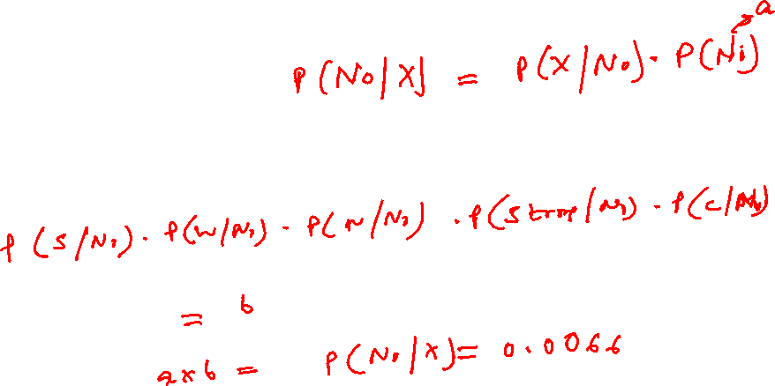
Sky | AirTemp | Humidity | Wind | Forecast | Enjoy Sport?
Sunny | Warm | Normal | Strong | Same | Yes
Sunny | Warm | High | Strong | Same | No
Rainy | Cold | High | Strong | Change | No
Sunny | Warm | Normal | Breeze | Same | Yes
Sunny | Hot | Normal | Breeze | Same | No
Rainy | Cold | High | Strong | Change | No
Sunny | Warm | High | Strong | Change | Yes
Sunny | Warm | Normal | Strong | Change | ????
Rainy | Warm | Normal | Breeze | Same | ????

Slide 26
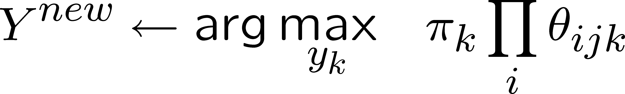
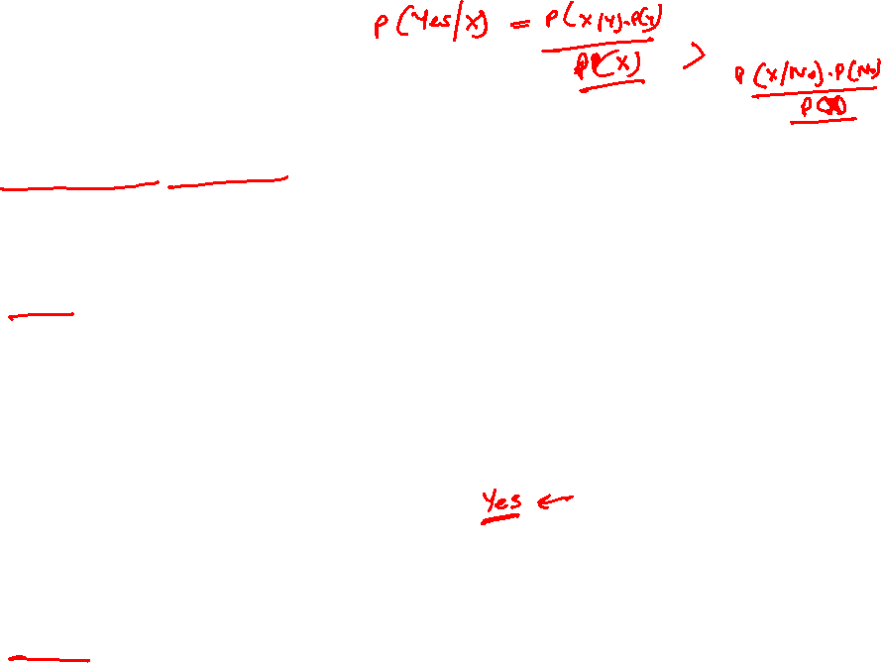
Example: Play Tennis - Testing Phase
  MAP rule
P(Enjoy=Yes | X) = P(X | Enjoy=Yes). P(Enjoy=Yes) / P(X)
= P(X | Enjoy=Yes). P(Enjoy=Yes)
= P(X | Enjoy=Yes). (3/7)
= P(Sunny | Enjoy=Yes). P(Warm | Enjoy=Yes). P(Normal | Enjoy=Yes). P(Strong | Enjoy=Yes). P(Change | Enjoy=Yes).(3/7)
= (3/3) . (3/3) . (2/3) . (2/3) . (1/3) . (3/7)
=0.0635
P(Enjoy=Yes | X) > P(Enjoy=No | X) → EnjoySport = Yes
P(Enjoy=No | X) = P(X | Enjoy=No). P(Enjoy=No) / P(X)
= P(X | Enjoy=No). P(Enjoy=No)
= P(X | Enjoy=No). (4/7)
= P(Sunny | Enjoy=No). P(Warm | Enjoy=No). P(Normal | Enjoy=No). P(Strong | Enjoy=No). P(Change | Enjoy=No). (4/7)
= (2/4) . (1/4) . (1/4) . (3/4) . (2/4) . (4/7)
= 0.006696
Sky | AirTemp | Humidity | Wind | Forecast | Enjoy Sport?
Sunny | Warm | Normal | Strong | Same | Yes
Sunny | Warm | High | Strong | Same | No
Rainy | Cold | High | Strong | Change | No
Sunny | Warm | Normal | Breeze | Same | Yes
Sunny | Hot | Normal | Breeze | Same | No
Rainy | Cold | High | Strong | Change | No
Sunny | Warm | High | Strong | Change | Yes
Sunny | Warm | Normal | Strong | Change | ????
Rainy | Warm | Normal | Breeze | Same | ????

Slide 27
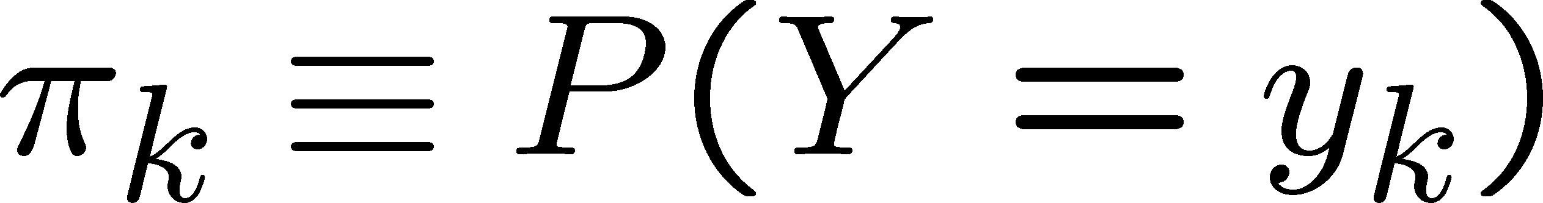

Naïve Bayes Algorithm – discrete X_{i}
Train Naïve Bayes (examples) for each* value y_{k}
estimate
for each* value x_{ij} of each attribute X_{i}
estimate
Classify (X^{new})

Slide 28
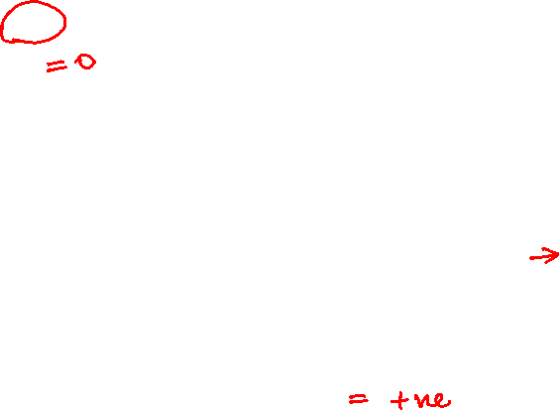
Example: Play Tennis
P(Enjoy=Yes | X) = P(X | Enjoy=Yes). P(Enjoy=Yes) / P(X)
= P(X | Enjoy=Yes). P(Enjoy=Yes)
= P(X | Enjoy=Yes). (3/7)
= P(Rainy | Enjoy=Yes). P(Warm | Enjoy=Yes). P(Normal | Enjoy=Yes). P(Breeze | Enjoy=Yes). P(Same | Enjoy=Yes).(3/7)
= (0/3) . (3/3) . (2/3) . (1/3) . (2/3) . (3/7)
P(Enjoy=No | X) = P(X | Enjoy=No). P(Enjoy=No) / P(X)
= P(X | Enjoy=No). P(Enjoy=No)
= P(X | Enjoy=No). (4/7)
= P(Rainy | Enjoy=No). P(Warm | Enjoy=No). P(Normal | Enjoy=No). P(Breeze | Enjoy=No). P(Same | Enjoy=No). (4/7)
= (2/4) . (1/4) . (1/4) . (1/4) . (2/4) . (4/7)
Sky
Sunny
Sunny
Rainy
Sunny
Sunny
Rainy
Sunny
Rainy
AirTemp | Humidity | Wind | Forecast | Enjoy Sport?
Warm | Normal | Strong | Same | Yes
Warm | High | Strong | Same | No
Cold | High | Strong | Change | No
Warm | Normal | Breeze | Same | Yes
Hot | Normal | Breeze | Same | No
Cold | High | Strong | Change | No
Warm | High | Strong | Change | Yes
Warm | Normal | Breeze | Same | ????

Slide 29
Laplace Smoothing

Slide 30
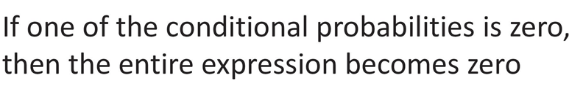
Smoothing
Technique for smoothing categorical data.
A small-sample correction, or pseudo-count, will be incorporated in every probability estimate.
No probability will be zero.

Slide 31
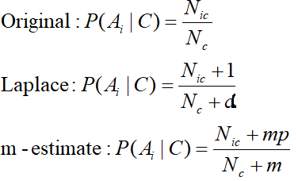
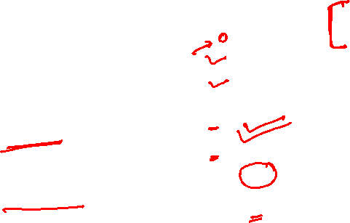
Smoothing
Probability estimation:
d: number of distinct values of an attribute
N_{c}: number of instances in the class
N_{ic}: number of instances having attribute value A_{i} in class c
p: prior probability of the class
m: constant called the equivalent sample size, which determines how heavily to weight p relative to the observed data
Bayesian approach

Slide 32

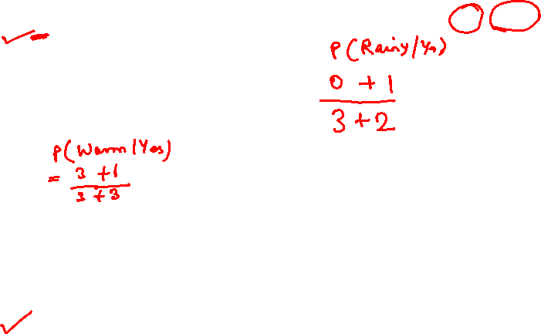
Example: Play Tennis
P(Enjoy=Yes | X) = P(X | Enjoy=Yes). P(Enjoy=Yes) / P(X)
= P(X | Enjoy=Yes). P(Enjoy=Yes)
= P(X | Enjoy=Yes). (3/7)
= P(Rainy | Enjoy=Yes). P(Warm | Enjoy=Yes). P(Normal | Enjoy=Yes). P(Breeze | Enjoy=Yes). P(Same | Enjoy=Yes).(3/7)
= (0+1/3+2) . (3 +1/3+3) . (2+1/3+2) . (1+1/3+2) . (2+1/3+2) . (3/7)
For Laplace smoothing α = 1
P(Enjoy=No | X) = P(X | Enjoy=No). P(Enjoy=No) / P(X)
= P(X | Enjoy=No). P(Enjoy=No)
= P(X | Enjoy=No). (4/7)
= P(Rainy | Enjoy=No). P(Warm | Enjoy=No). P(Normal | Enjoy=No). P(Breeze | Enjoy=No). P(Same | Enjoy=No). (4/7)
= (2+1/4+2) . (1+1/4+3) . (1+1/4+2) . (1+1/4+2) . (2+1/4+2) . (4/7)
Sky | AirTemp | Humidity | Wind | Forecast | Enjoy Sport?
Sunny | Warm | Normal | Strong | Same | Yes
Sunny | Warm | High | Strong | Same | No
Rainy | Cold | High | Strong | Change | No
Sunny | Warm | Normal | Breeze | Same | Yes
Sunny | Hot | Normal | Breeze | Same | No
Rainy | Cold | High | Strong | Change | No
Sunny | Warm | High | Strong | Change | Yes
Sunny | Warm | Normal | Strong | Change | ????
Rainy | Warm | Normal | Breeze | Same | ????

Slide 33

Example: Play Tennis
P(Enjoy=Yes | X) = P(X | Enjoy=Yes). P(Enjoy=Yes) / P(X)
= P(X | Enjoy=Yes). P(Enjoy=Yes)
= P(X | Enjoy=Yes). (3/7)
= P(Rainy | Enjoy=Yes). P(Warm | Enjoy=Yes). P(Normal | Enjoy=Yes). P(Breeze | Enjoy=Yes). P(Same | Enjoy=Yes).(3/7)
= (1/5) . (4/6) . (3/5) . (2/5) . (3/5) . (3/7)
=0.00822
P(Enjoy=Yes | X) > P(Enjoy=No | X) → EnjoySport = Yes
P(Enjoy=No | X) = P(X | Enjoy=No). P(Enjoy=No) / P(X)
= P(X | Enjoy=No). P(Enjoy=No)
= P(X | Enjoy=No). (4/7)
= P(Rainy | Enjoy=No). P(Warm | Enjoy=No). P(Normal | Enjoy=No). P(Breeze | Enjoy=No). P(Same | Enjoy=No). (4/7)
= (3/6) . (2/7) . (2/6) . (2/6) . (3/6) . (4/7)
= 0.00453
Sky | AirTemp | Humidity | Wind | Forecast | Enjoy Sport?
Sunny | Warm | Normal | Strong | Same | Yes
Sunny | Warm | High | Strong | Same | No
Rainy | Cold | High | Strong | Change | No
Sunny | Warm | Normal | Breeze | Same | Yes
Sunny | Hot | Normal | Breeze | Same | No
Rainy | Cold | High | Strong | Change | No
Sunny | Warm | High | Strong | Change | Yes
Sunny | Warm | Normal | Strong | Change | ????
Rainy | Warm | Normal | Breeze | Same | ????

Slide 34
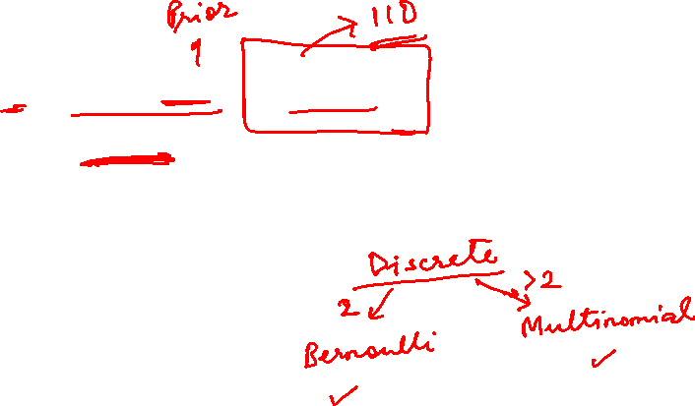
Naïve Bayes: Continuous Features
$X_{i}$ can be continuous
Naïve Bayes classifier:
$$Y=\arg{\max_{y}{P\left(Y=y\right)\prod_{i}{P(X_{i}|Y=y)}}}$$
Assumption: $P(X_{i}|Y)$has a Gaussian distribution

Slide 35


The Gaussian Probability Distribution
It is a continuous distribution with pdf:
$$ = mean of distribution
$σ^{2}$ = variance of distribution
$x$ is a continuous variable ($−∞≤x≤∞)$
$$p\left(x\right)=\frac{1}{σ\sqrt{2π}}e^{−\frac{{\left(x −μ\right)}^{2}}{2 σ^{2}}}$$
x

Slide 36
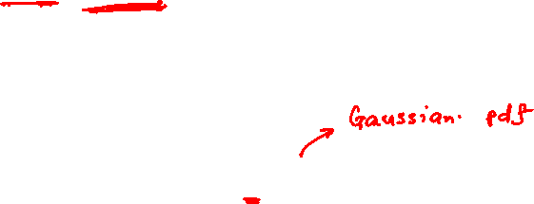
Continuous Features : learning and prediction
For each target value Y_{k} (MLE estimate)
P($Y=y_{k}$) ← No. of instances with Y_{k} class/No. of Total instances
For each attribute value X_{i} estimate $P \left(X_{i}\right|Y=y_{k})$
  class conditional mean , variance
Classify New Instance(x)
Pick the most probable (MAP) Y
$$\hat{Y}←\underset{y_{k}}{argmax}{P\left(Y=y_{k}\right)Π_{i}P\left(X_{i}\right|Y=y_{k})}$$

Slide 37
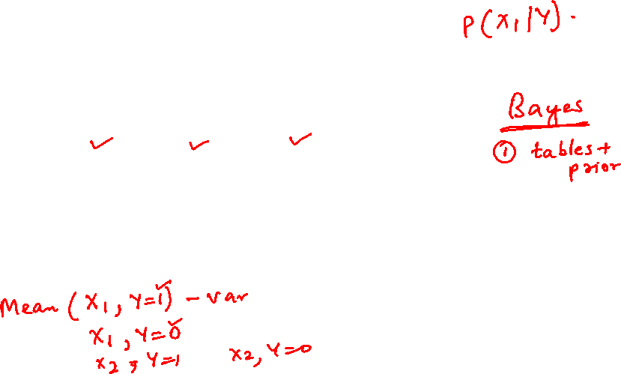
Continuous Features : learning
$P(X_{i}|Y)$is Gaussian
Training: estimate mean and standard deviation
  $μ_{i}=E\left[X_{i} | Y=y\right]$
  $σ_{i}^{2}=E\left[{\left(X_{i}−μ_{i}\right)}^{2} | Y=y\right]$
$$X_{1}$$ | $$X_{2}$$ | $$X_{3}$$ | $$Y$$
$$2$$ | $$3$$ | $$1$$ | $$1$$
$$−1.2$$ | $$2$$ | $$0.4$$ | $$1$$
$$1.2$$ | $$0.3$$ | $$0$$ | $$0$$
$$2.2$$ | $$1.1$$ | $$0$$ | $$1$$

Slide 38
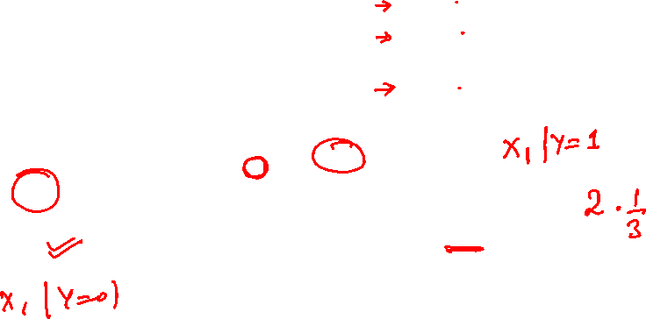
Continuous Features : learning
$$X_{1}$$ | $$X_{2}$$ | $$X_{3}$$ | $$Y$$
$$2$$ | $$3$$ | $$1$$ | $$1$$
$$−1.2$$ | $$2$$ | $$0.4$$ | $$1$$
$$1.2$$ | $$0.3$$ | $$0$$ | $$0$$
$$2.2$$ | $$1.1$$ | $$0$$ | $$1$$
  $μ_{i}=E\left[X_{i} | Y=y\right]$
  $σ_{i}^{2}=E\left[{\left(X_{i}−μ_{i}\right)}^{2} | Y=y\right]$
  $μ_{1}=E\left[X_{1} | Y=1\right]=\frac{2+\left(−1.2\right)+2.2}{3}=1$
  $σ_{1}^{2}=E\left[\left(X_{1}−μ_{1}\right) | Y=1\right]=$
  $$\frac{{{\left(2−1\right)}^{2}+{\left(−1.2 −1\right)}^{2}+\left(2.2 −1\right)}^{2}}{3}=2.43$$

Slide 39
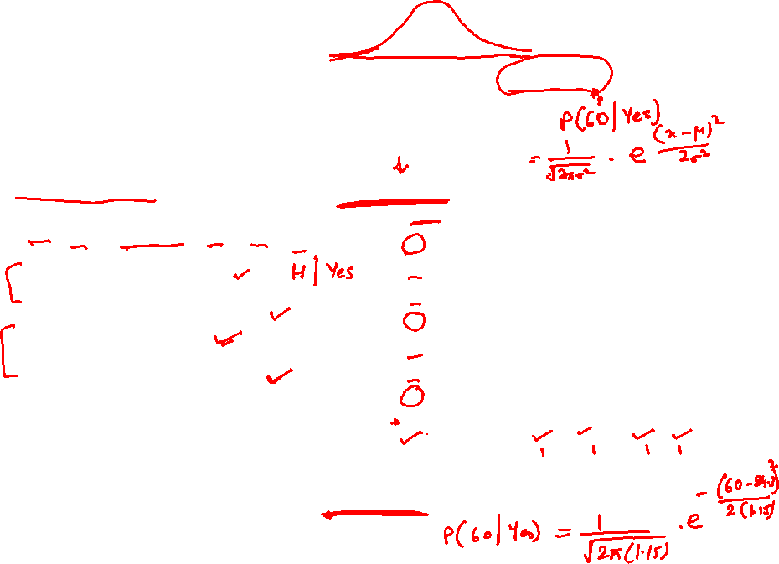
Example: Play Tennis
P(X|Y) ~ N(μ, σ²) $→ GaussianNB$ (X_{i} – real valued)
P(Enjoy=Yes | X) = P(X | Enjoy=Yes). P(Enjoy=Yes) / P(X)
= P(X | Enjoy=Yes). P(Enjoy=Yes)
= P(X | Enjoy=Yes). (3/7)
= P(Rainy | Enjoy=Yes). P(Warm | Enjoy=Yes). P(60 | Enjoy=Yes). P(Breeze | Enjoy=Yes). P(Same | Enjoy=Yes).(3/7)
= (1/3) . (3/3) . 0.15*10⁻⁹⁵ . (1/3) . (2/3) . (3/7)
P(Enjoy=No | X) = P(X | Enjoy=No). P(Enjoy=No) / P(X)
= P(X | Enjoy=No). P(Enjoy=No)
= P(X | Enjoy=No). (4/7)
= P(Rainy | Enjoy=No). P(Warm | Enjoy=No). P(60 | Enjoy=No). P(Breeze | Enjoy=No). P(Same | Enjoy=No). (4/7)
= (2/4) . (1/4) . 0.02 . (1/4) . (2/4) . (4/7)
Humidity | Enjoy Sport?
85 | Yes
80 | No
70 | No
83 | Yes
90 | No
50 | No
85 | Yes
60 | ????
AirTemp | Sky | Wind | Forecast | Enjoy Sport?
Warm | Sunny | Strong | Same | Yes
Warm | Sunny | Strong | Same | No
Cold | Rainy | Strong | Change | No
Warm | Rainy | Breeze | Same | Yes
Hot | Sunny | Breeze | Same | No
Cold | Rainy | Strong | Change | No
Warm | Sunny | Strong | Change | Yes
Warm | Rainy | Breeze | Same | ????
  $μ_{i}=E\left[X_{i} | Y=yes\right]$ = 84.33
  $σ_{i}^{2}=E\left[{\left(X_{i}−μ_{i}\right)}^{2} | Y=yes\right]$ = 1.15
  $μ_{i}=E\left[X_{i} | Y=no\right]$ = 72.5
  $σ_{i}^{2}=E\left[{\left(X_{i}−μ_{i}\right)}^{2} | Y=no\right]$ = 17.08

Slide 40
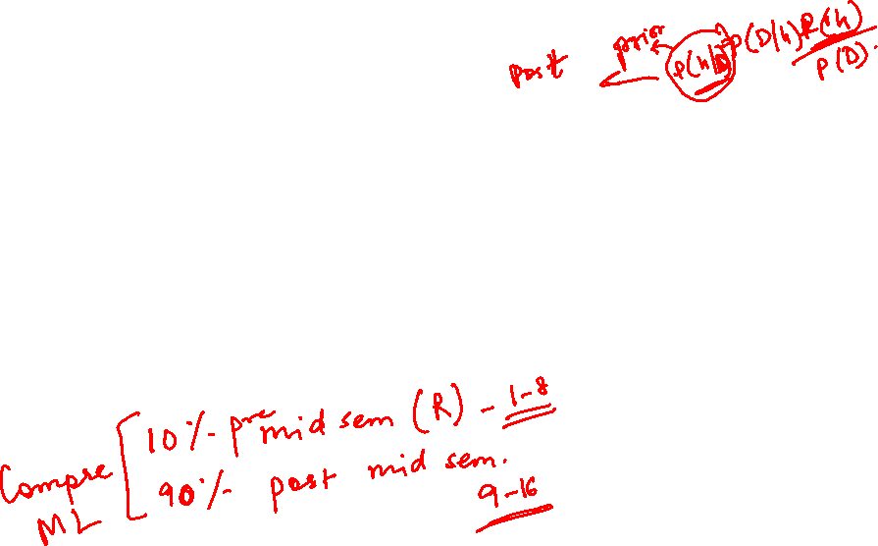
Additional Exercises – For Student’s Practice
As a part of efforts to improve students’ performance in the exams, you have been given the data showing number of study hours spent by students, their gender and their final results as pass or fail. Using this sample dataset, apply Naïve Bayes classification technique, to classify the below test case:
{No of study hours = 3.5, Gender=”male”} either as “Pass”, or “Fail”.
No of study hours | Gender | Final result
4.5 | Male | Pass
7 | Female | Pass
2 | Male | Fail
4 | Female | Fail
2.5 | Male | Fail
3 | Female | Fail
8.3 | Male | Fail
8 | Female | Pass
9 | Male | Pass
Tip: P(X|Y) ~ N(μ, σ²) $→ GaussianNB$ (X_{i} – real valued)

Slide 41
Additional Exercises – For Student’s Practice
P(Pass | X) = P(X | Pass). P(Pass) / P(X)
= P(X | Pass). P(Pass)
= P(X | Pass). (0.44)
= P(Male | Pass). P(3.5 | Pass).(0.44)
= (2/4). 0.1056 . (0.44) = 0.0235
P(Fail | X) = P(X | Fail). P(Fail) / P(X)
= P(X | Fail). P(Fail)
= P(X | Fail). (0.56)
= P(Male | Fail). P(3.5 | Fail).(0.56)
= (3/5). 0.1846 . (0.56) = 0.0615
No of study hours | Gender | Final result
4.5 | Male | Pass
7 | Female | Pass
2 | Male | Fail
4 | Female | Fail
2.5 | Male | Fail
3 | Female | Fail
8.3 | Male | Fail
8 | Female | Pass
9 | Male | Pass

Slide 42
Thank you !
Required Reading for completed session :
T1 - Chapter # 8 (Tom M. Mitchell, Machine Learning)
T1 - Chapter # 6 (Tom M. Mitchell, Machine Learning)
R1 – Chapter # 3 (Christopher M. Bhisop, Pattern Recognition & Machine Learning) & Refresh your MFDS & ISM parallel course basics

